Slide 1

English for Telephoning
Class: 18C1-NNA1
Time: 14.10 – 15.40 on
Lecturer: Ms. Nguyen Thi Thanh Tu
Faculty of Foreign Languages
Ly Tu Trong College of Ho Chi Minh City
Unit 3: Let me get back to you on that

Slide 2

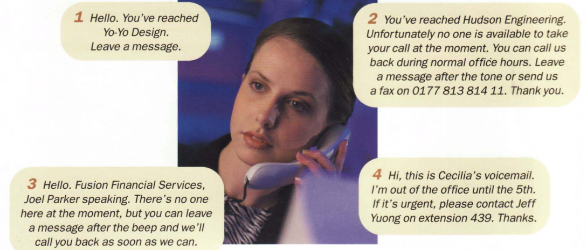
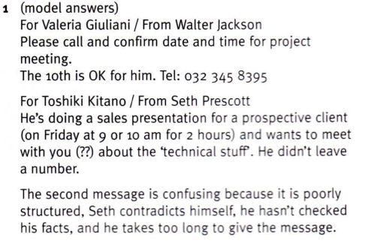

Slide 3
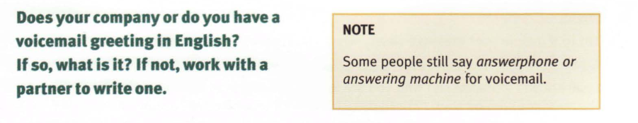

Slide 4
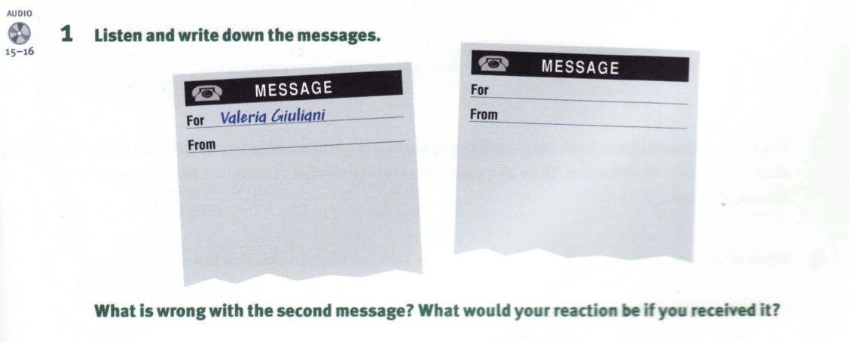

Slide 5
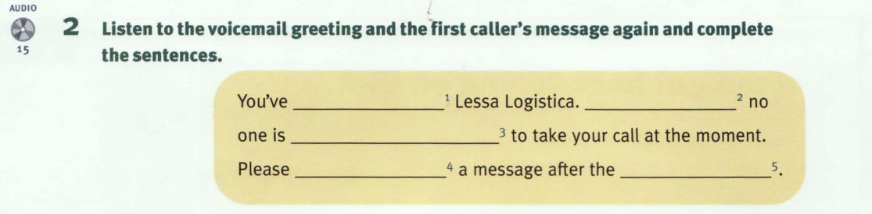
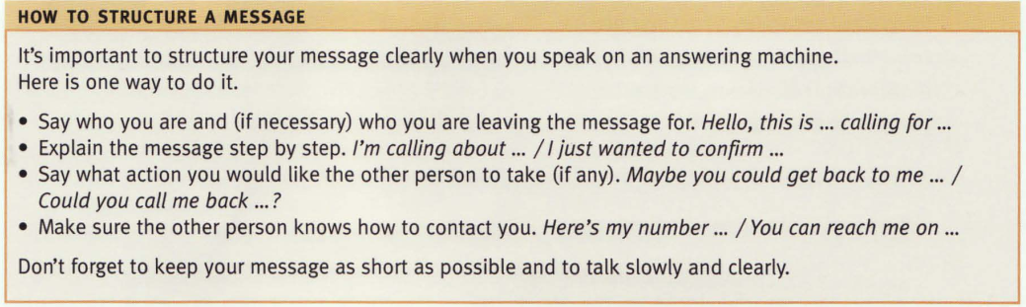
reached
Unfortunately
available
leave
beep

Slide 6
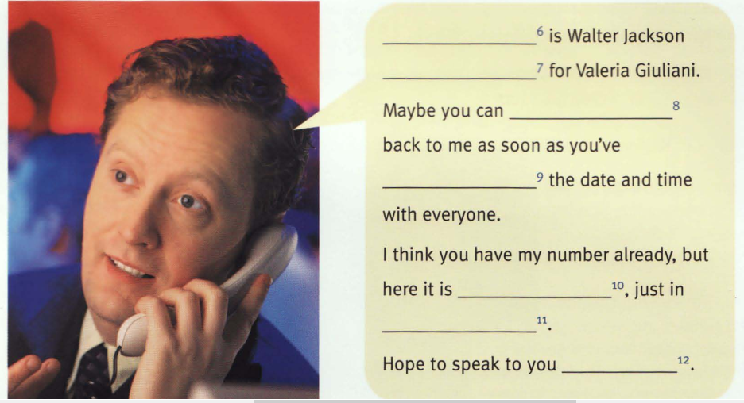
This
calling
get
confirmed
again
case
soon

Slide 7
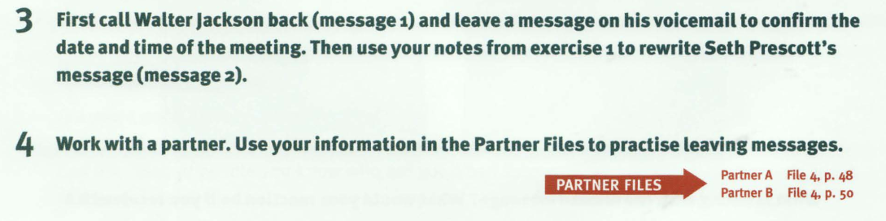
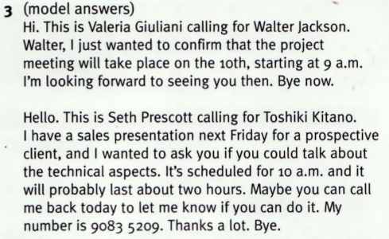

Slide 8
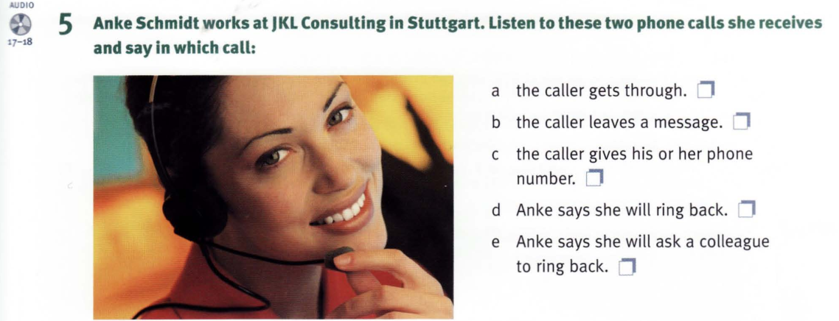
Call 2
Call 1
Call 2
Call 2
Call 1

Slide 9
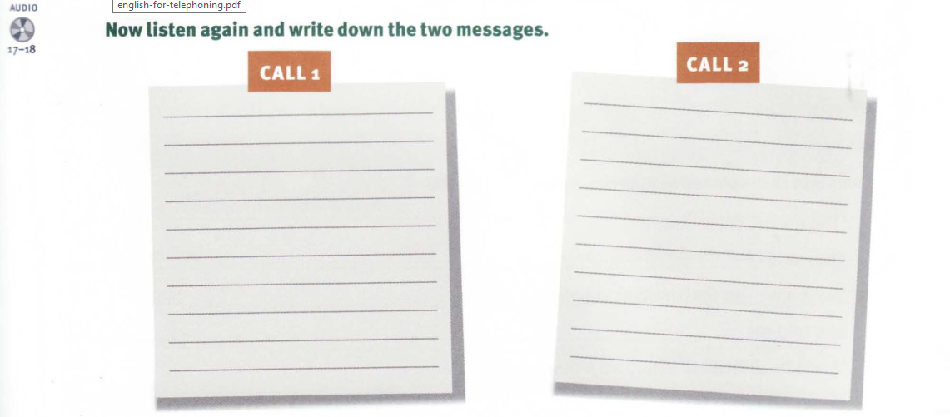
Jonathan, Ricardo Fonseca from Aresto called about the EuroMedical fair next week. He wanted to know if you’re going and if you and he can meet. Please call him back. He’ll be in the office until 5 p.m. today.
Elaine Sloan called about the team for the new marketing campaign. She wanted to know if Henry can still be on the team if they shift the deadline back a week. Call back today on 44 141 223 4569

Slide 10
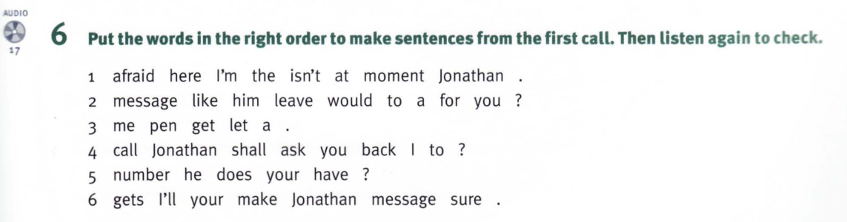
1. I’m afraid Jonathan isn’t here at the moment.
2. Would you like to leave a message for him?
3. Let me get a pen.
4. Shall I ask Jonathan to call you back?
5. Does he have your number?
6. I’ll make sure Jonathan gets your message.

Slide 11
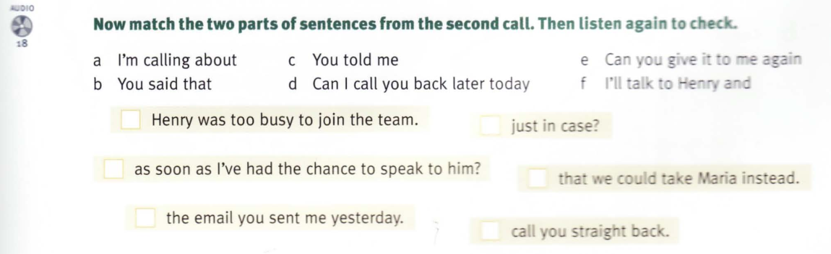
a. I’m calling about the email you sent me yesterday.
b. You said that Henry was too busy to join the team.
c. You told me that we we could take Maria instead.
d. Can I call you back later today as soon as I’ve had the chance to speak to him?
e. Can you give it to me again just in case?
f. I’ll take to Henry and call you straight back.

Slide 12
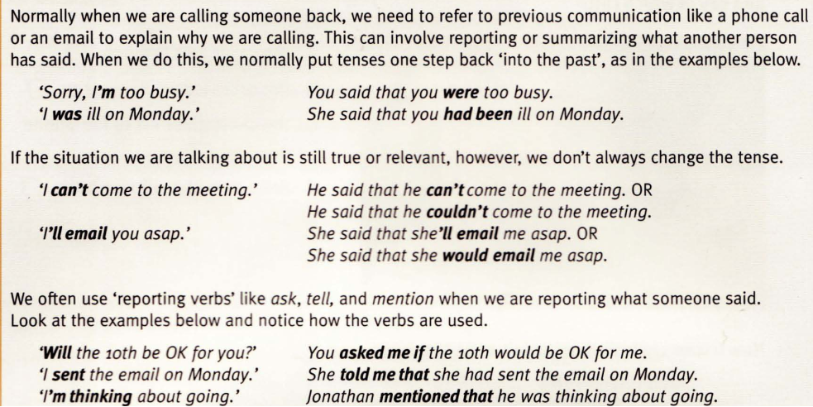
Referring to previous communication

Slide 13
Homework:
After these two periods you have to remember Useful Phrases;
do exercises in the part 6 , and read ‘referring to previous communication’
Prepare for unit 3: (cont.) Let me get back to you on that

